Slide 1
Networking and Communication

Slide 2
Learning Objectives
Upon successful completion of this chapter, you will be able to:
understand the history and development of networking technologies.
Define the key terms associated with networking technologies.
Understand the importance of broadband technologies.
Describe organizational networking.

Slide 3
A Brief History of the Internet
ARPANET: Advanced Research Projects Agency Network
  Cold War – military or intelligence advantage
  ARPA requested proposals for communication technology
  Bolt, Beranek, and Newman (BBN) completed project in 1 year
  Four nodes: UCLA, Stanford, MIT, & University of Utah
Introduction of the Internet
  New networks but different languages (protocol)
  Solution: transmission control protocol/Internet protocol (TCP/IP)
  Internet: an interconnected network of networks

Slide 4
Internet Terms
Packet – data sent over the internet
Hub – connects other devices to the network and sends packets to all devices connected to it.
Bridge – connects two networks together and filters packets.
Switches – connects multiple devices and filters packets based upon destination.
Router – receives and analyzes packets, then sends them to specific destinations.

Slide 5
Internet Terms (contd.)
Internet Protocol (IP) Address – Unique number that identifies a device.
  IPv4: ###.##.###.###
    Limit 4,294,967,296 addresses
  IPv6: ####.####.####.####.####.####.####.####
    Hexadecimals are base 16 (0 1 2 3 4 5 6 7 8 9 a b c d e f)
    Limit 3.4 x 10³⁸ addresses
Domain Name (Google - 74.125.224.72) – common name for a Website so you don’t have to remember the IP address.
Domain Name System (DNS) – throughout the internet. Translates domain names to IP addresses.
.
Packet-switching – How packets travel across a network, through routers. Multiple packets may be broken up and sent different routes.
Protocol – Set of rules that allow devices to exchange information

Slide 6

Internet and the World Wide Web
Primary Internet users in 1980s:
government, academic, and research
organizations
Driven by use of e-mail
World Wide Web project
  Graduate Student Tim Berners-Lee, needed a way to link his dissertations advisors comments together: Hypertext.
  1993 Mosaic browser allowed combinations of text and graphics
  1994 Netscape Navigator first commercial web browser

Slide 7
Dot-Com Bubble
National Science Foundation (NSF)
  Managed Internet until early 1990s
  Restricted commercial ventures
1991 NSF transfers control to US Government
  Commercial use of the Internet is now possible
  Surge of investment in online companies
  Investors understood e-commerce would be highly profitable
  Poor business models led to widespread failures
  2000-2001, many internet companies went bust (Dot-Com Bubble, Dot-Bomb)
  Dot com bubble was a rapid rise in U.S. tech stock equity as a result of investment in internet based companies.
  Companies needed better strategies and management to survive

Slide 8
Web 2.0
Web 1.0
  Web pages
  Not interactive
  People find and view information but don’t‘ interact with it
Web 2.0
  Users can communicate with Web sites and each other
  YouTube, Wiki, Flickr, Facebook…etc.
Web 3.0 – Semantic Web – emerging now

Slide 9
Sidebar: Internet vs. WWW
What is the difference?
  Not the same
  WWW is part of the Internet
Internet: A network of networks, across the planet.
WWW: Web servers with HTML pages that are viewed on devices with Web browsers.

Slide 10
Growth of Broadband
In the 70s/80s people used dial up modems to connect to computers.
  Tied up phone lines
  Hindered usage – too slow
  Speed measured in bps
Cable or DSL (or satellite) offered higher speed
Broadband (-coaxial cable, fibre optics and radio waves)
  Connections faster than 256,000 bps (speeds are much higher now)
  Average home broadband speed is between 3 mbps and 30 mbps
  Enabled growth of new businesses and ways that people use technology
Notes:
DSL (Digital subscriber line)

Slide 11
Wireless Networking
Wi-Fi: allows devices to connect to the internet through a wi-Fi enabled router.
Mobile Network: a telecom that provides services to mobile devices via radio waves.
Bluetooth: radio waves for information transfer
VoIP: the tech. that allows you to make call through broadband instead of telephone lines.

Slide 12
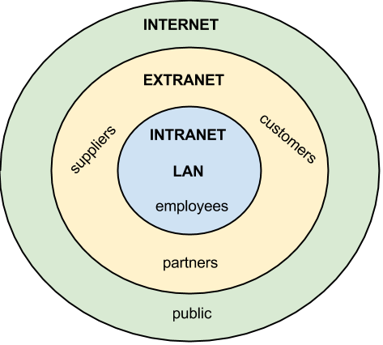
Organizational Networking
Intranet – within the organization.
Extranet – allowing partners into your network for specific things (eg. Supply Chain Management)
Internet

Slide 13
Cloud Computing
Is the on-demand availability of computer system resources, especially data storage and computing power, without direct active management by the user.
Notes:
Remember those network diagrams. The Internet was always represented by a cloud. This wasn’t an accident. When people say cloud computing, they mean that you will get your computing services over the internet.

Slide 14
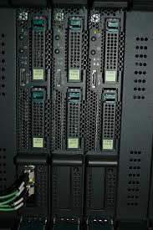
Cloud Computing
cloud
In house
farm
Notes:
So, when you got services in-house, you went to your own companies data center. Maybe you used it to access reports on sales data and business intelligence about your Web site promotions.
If you want to do this in a cloud environment, it would be exactly the same. However, you wouldn’t be accessing a local data center, you would access a data center through the Internet and since many companies use that service it would be a lot larger than your own, in-house data center.

Slide 15
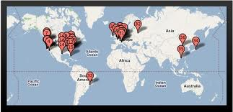
Google’s Server Farms or Data Centers
A facility that has hardware and networking equipment that serves as the backbone of a cloud provider’s infrastructure.
Notes:
This is a map you can find online, showing all of Google’s Data Centers.

Slide 16
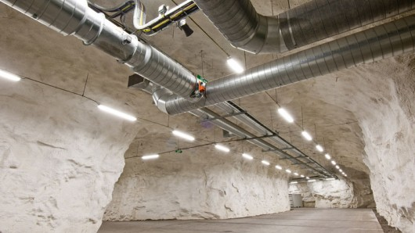
Data Farms
Headlines
  Fjord Cooled Data Center in Norway is the Worlds Greenest Data Center
  Facebook to Build Server Farm at the Artic Circle
Economies
  Maintenance
  Labor
  Dynamic Scaling
  Backup and Recovery
  Cost
Notes:
It is funny to read current headlines about smartly located server farms.
“Fjord Cooled Data Center is Norway is Worlds Greenest Data Center”. It sounds crazy but, Norway is cold and they do have these tunnels that were perfect for hosting computer data centers. By piping in water from the Fjords, glacial waterways, the data center is said to generate no carbon emissions. The electrical power is from hydroelectric dams.
Another story, “Facebook to Build Server Farm at the Artic Circle.” is a similar one. By taking advantage of naturally occurring climates, a data center can be much more environmentally friendly.
Other economies that a large facility can offer are in:
Maintenance: your company no longer has to worry about maintaining servers. The cloud company does that for you.
Labor: the labor is effectively outsourced, so you don’t have to pay for as many people to maintain the data center.
Dynamic scaling: Since the cloud company has a giant server base, if your firm needs more or less computing power, that company using dynamic scaling to increase of decrease what you use on the fly.
Backup and recovery. Again the cloud company can provide for this.
Cost. All the items above can represent a significant cost savings to your company.

Slide 17
Cloud Computing Problems
Security
Access – if you lose Internet, it’s over
Isn’t always as easy as it seams
Service from a giant host might not be as good as what you get in-house
Locked in to a specific service provider
Notes:
It cannot be all good or everyone would be using cloud computing right now.
There are a lot of concerns about cloud computing and information security. If I put all my customer data with a cloud company, how do I know it is secure? Many companies feel it is too risky to put critical applications and data into someone else’s control. So, you see a lot of companies use a hybrid approach where they use cloud computing for non-critical functions and keep the critical, strategic functions and data in-house.
Cloud computing often sounds all good. But, in practice, there are some difficulties. If your Internet access goes down, there is not way for you to operate at all.
If something goes wrong and you own your own data center, you’re a lot more likely to influence the result than with a cloud vendor in another country.
Also, your company may become locked in to a specific service provider and then not be able to change later on.

Slide 18
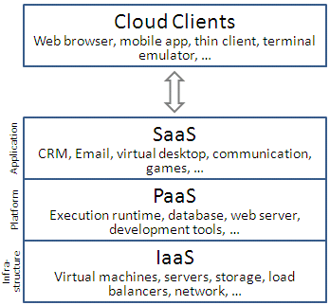
Services from the Cloud
Platform as a Service (PaaS) – hardware/software tools
Software as a
Service (SaaS) - applications
Infrastructure as a
Service (IaaS) – storing, computing and networking resources.
Notes:
Cloud computing services is often described as “fill in the blank, as a service.” There are many different services that cloud computing offers. The big 3 are:
Platform as a Service (PaaS)
Software as a Service (SaaS)
Infrastructure as a Service (IaaS)
This figure from Wikipedia gives examples of each.
IaaS, infrastructure as a service, would inlcude virtual machines, servers, storage and load balancers to distribute your processing needs.
PaaS, Platform as a service, runs your database, web servers and development tools. It’s the environments you are running to do business.
SaaS, Software as a service is your applications. Maybe CRM, eMail, games, ERP…etc.

Slide 19

Summary
Reviewed the history and development of networking technologies.
Defined the key terms associated with networking technologies.
Review the importance of broadband technologies.
Describe organizational networking at a high level.

